Slide 1
FUNCTIONAL VERIFICATION AND FAULT MODELING OF A RISC-V REGISTER FILE USING SYSTEMVERILOG
Group 9:
Zherong Yu(zryu@ucdavis.edu)
Camille Chang (tyuchang@ucdavis.edu)
Yating Chang (cyating@ucdavis.edu)
Chi-Yun (William) Wang (cywwang@ucdavis.edu)
EEC283 SQ25 ADVANCED DESIGN VERIFICATION OF DIGITAL SYSTEMS

Slide 2
Presentation Outline
Project Introduction
RISC - V Architecture Basics
Project Goals
RTL Design
Testbench (Deterministic Inputs & Random Generation Test)
Fault Injection (Stuck-ats & bit-flips)
Regression
Conclusion

Slide 3
Project Introduction
RISC-V Architecture:
An open-source, modular instruction set architecture (ISA) based on the Reduced Instruction Set Computing (RISC) principles
Allowing custom extensions without licensing fees, which enables innovation, flexibility, and cost savings across a wide range of computing applications
Register file: 32 × 32-bit general-purpose registers
Project focus:
Design a RISC-V-compatible register file
Verify correctness using SystemVerilog
Analyze fault resilience with modeled hardware errors (faults injection)

Slide 4
RISC - V Architecture Advantages
Open and Royalty-Free: No licensing fees, encouraging global adoption
Modular and Extensible: Optional standard extensions for tailoring performance (e.g., floating-point, vector, security)
Simplicity: Smaller instruction set enables efficient hardware and low power usage
Scalability: Applicable to embedded, consumer, automotive, and high-performance systems
Growing Ecosystem: Increasing support from tools, compilers (e.g., GCC, LLVM), and industry players

Slide 5
RISC - V Architecture Expected Future Growth
Market Size: Projected to grow from $6.1B (2023) to $92.7B (2030)
Unit Shipments: Expected to rise from 1.3B units (2023) to 16.2B units (2030)
Industry Adoption:
Automotive: 66% annual growth expected due to AI and edge computing needs
Consumer & Industrial: Widespread use in smart devices and IoT systems
AI and HPC: Companies like Rivos are developing RISC-V-based chips for AI workloads
Geopolitical Momentum: Asia - Pacific countries promoting RISC-V to reduce dependency on foreign IP

Slide 6
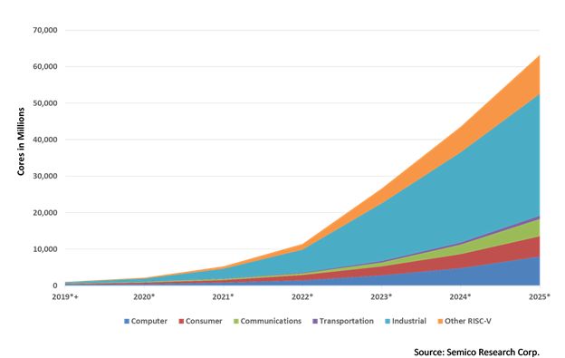
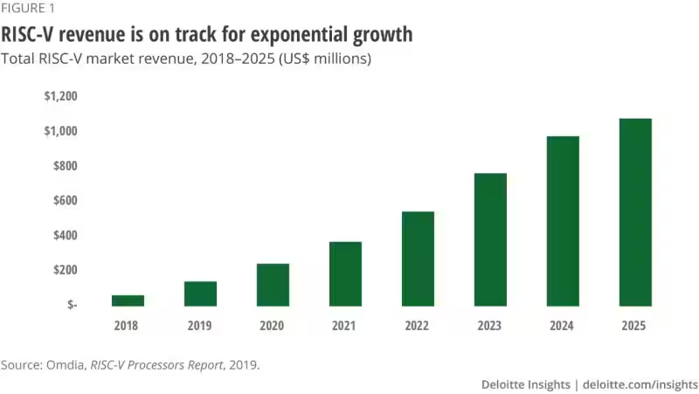
Expected Growth

Slide 7
Project Overview
Implement a parameterized 32×32 register file in Verilog
Enforce RISC-V constraints (e.g., x0 = 0)
Develop a SystemVerilog testbench
Deterministic and randomized testing
Measure and maximize functional coverage
Inject and analyze faults (stuck-at, bit-flip)
Regression

Slide 8
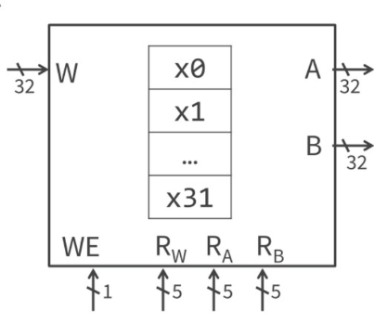
RISC-V Reg File Constraints
32 registers, each 32 bits wide
Dual asynchronous read ports
Single synchronous write port
x0 register: hardwired to 0 (write-protected)
Parameterized design to allow scalability
SystemVerilog-based RTL implementation

Slide 9
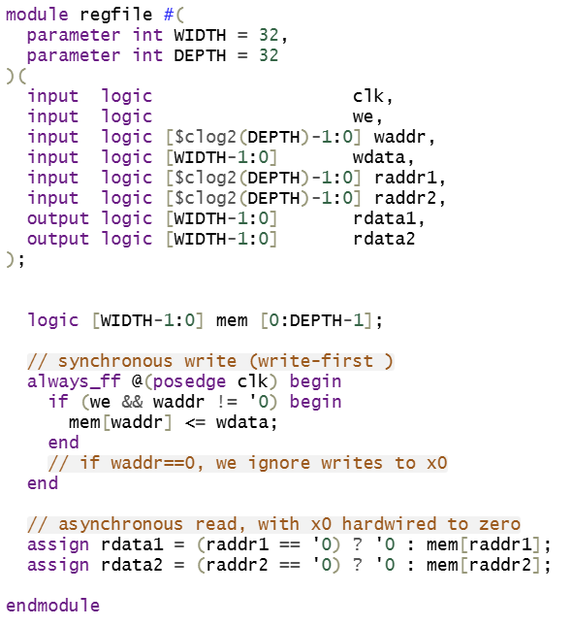
RTL Design
– 32×32 Storage Array
logic [WIDTH-1:0] mem [0:DEPTH-1];
– x0 Hardwired to Zero
In the always_ff block, if (waddr != 0) means writes to waddr == 0 (x0) are ignored. In the combinational reads, assign rdata = (raddr == 0) ? 32’h0 : mem[raddr] ensures any read from x0 always returns zero.
– Two Asynchronous Read Ports
– One Synchronous Write Port (Write-First)
On posedge clk, if we && waddr != 0, we perform mem[waddr] <= wdata;

Slide 10
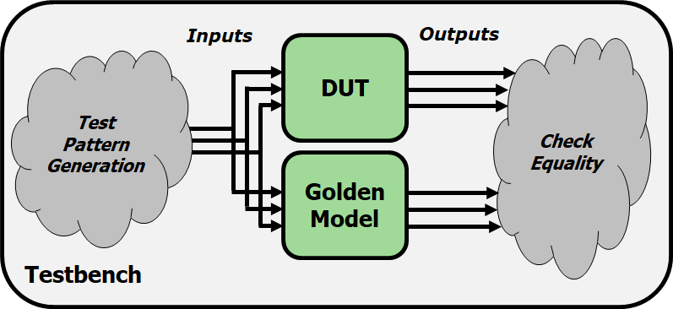
Testbench Structure
1) Clock generation: 10 ns period
2) Instantiate DUT + Golden Model
3) Checker: compare DUT outputs vs. Golden array
4) Directed Tests (4 corner‐case scenarios)
5) Randomized Tests (10 000 vectors)

Slide 11
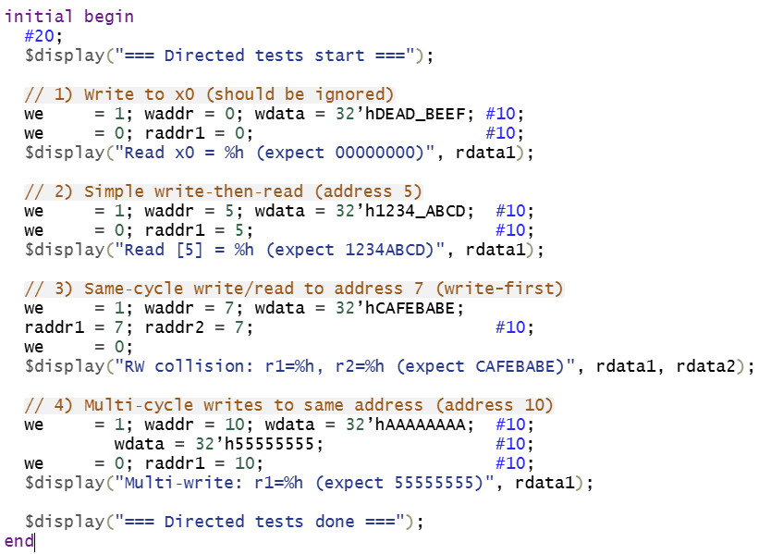
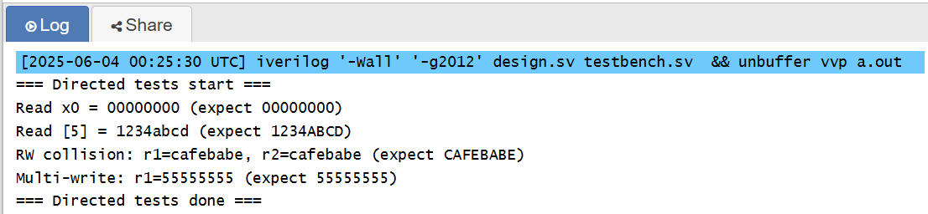
Deterministic Tests

Slide 12
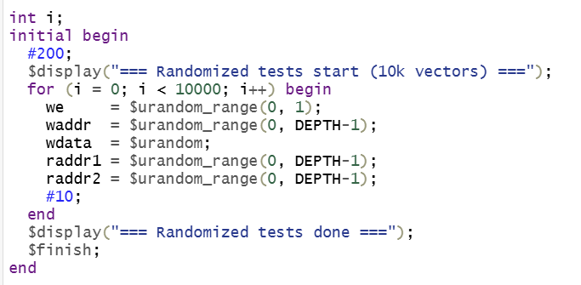
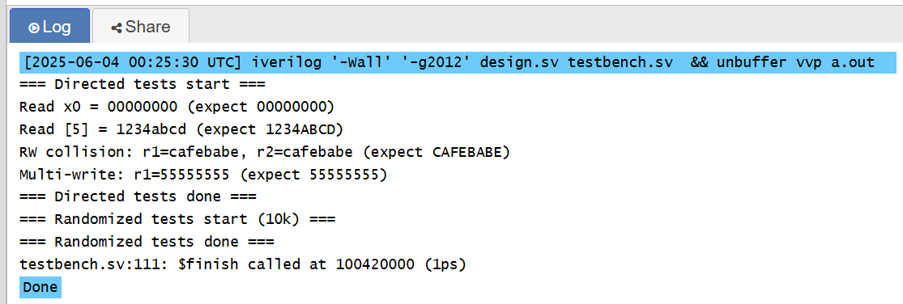
Randomized Tests
After a 200 ns delay, we launch 10 000 randomized vectors.
In each iteration:
– we = $urandom_range(0,1) selects random write‐enable.
– waddr, raddr1, raddr2 each get a random number 0..31.
– wdata is a random 32-bit value.
– We wait 10 ns so that each combination has exactly one clock cycle to propagate.

Slide 13
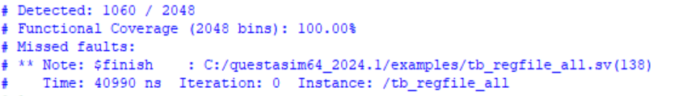
Test Coverage and Results (All Possible Single-BIt)
Register x0 = 00000000_00000000_00000000_00000000 (bit 31 .. bit 0)
Register x1 = 00000000_00000000_00000000_00000000
Register x2 = ...
...
Register x31 = 00000000_00000000_00000000_00000000
=> Total Possible Faults: 32x32x2=2048
EX: Register x15 = 00000000_00000000_00010000_00000000
↑ bit 18 (value = 1)
51.7%

Slide 14
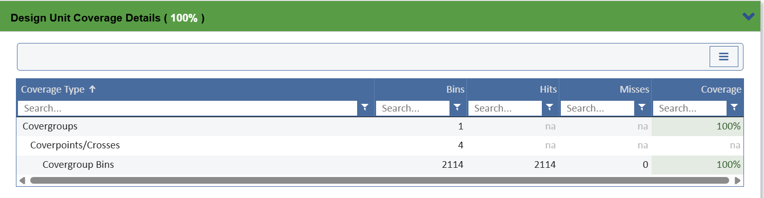
Test Coverage and Results

Slide 15
Test Coverage and Results (Random generation of Single-Bit stuck-at faults)
Covergroup | What It Tracks | Why It's Important
fault_cov | Fault type × register address | Ensures all stuck-at faults are tested broadly
write_cov | Write address × data pattern | Ensures variety in data stimulus per register
read_cov | Read address | Ensures every register is read and verified

Slide 16
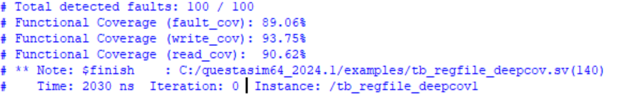
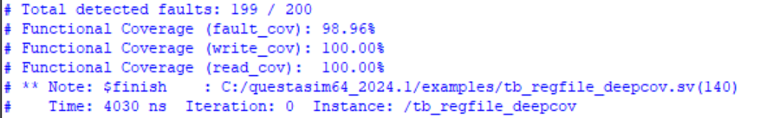
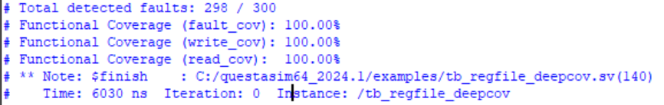
Test Coverage and Results (Random generation of Single-Bit stuck-at faults)
Weighted Avg = 94.96%
Weighted Avg = 97.04%
Weighted Avg = 97.56%

Slide 17
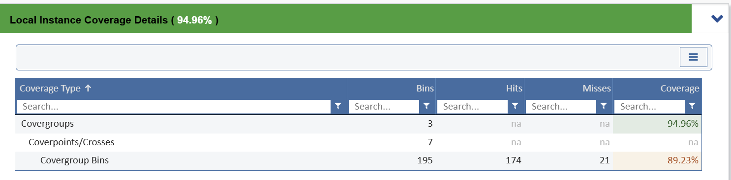
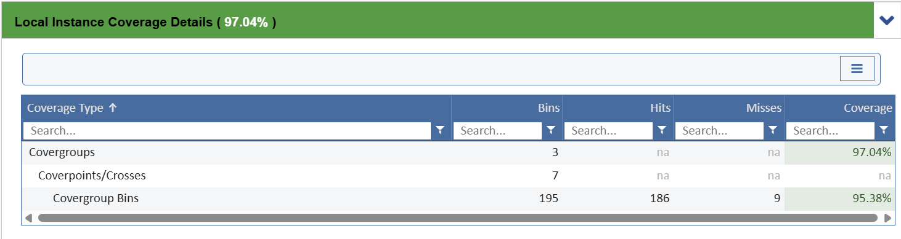

Test Coverage and Results (Random, Single-Bit stuck-at)

Slide 18
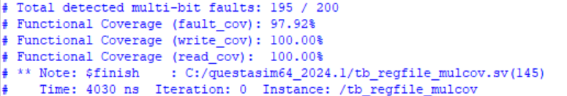
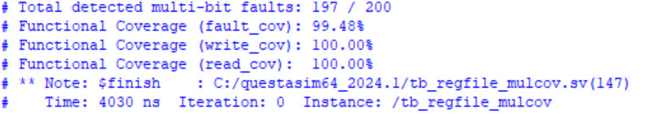
Test Coverage and Results (Multi-Bits stuck-at faults)
Inject faults into Bit 5, 18, and 27
Register x15 = 0x08040020 = 0000_1000_0000_0100_0000_0000_0010_0000
Weighted Avg = 99.56%

Slide 19
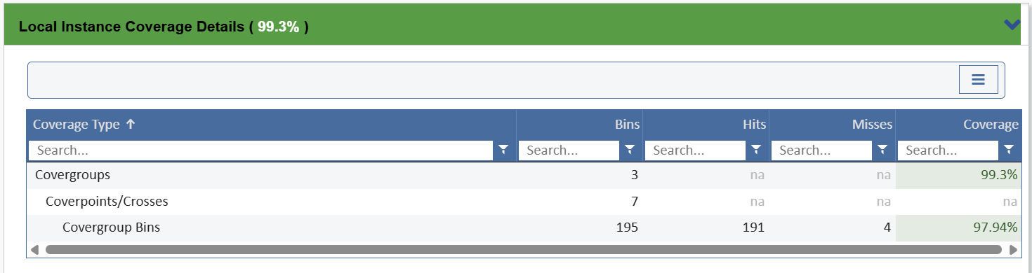
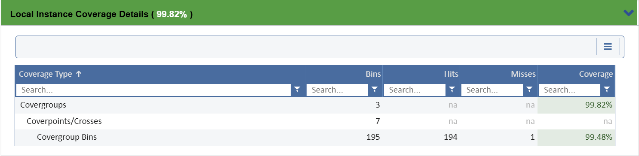
Test Coverage and Results (Multi-Bits stuck-at faults)

Slide 20


Test Coverage and Results (Single Bit-Flip Fault, Random Generation)
Possible Faults: 32x32=1024
EX: Register x15 = 0000_1000_0000_0100_0000_0000_0010_0000
↑ Toggle bit 18
=> 0000_1000_0000_0100_0100_0000_0010_0000

Slide 21
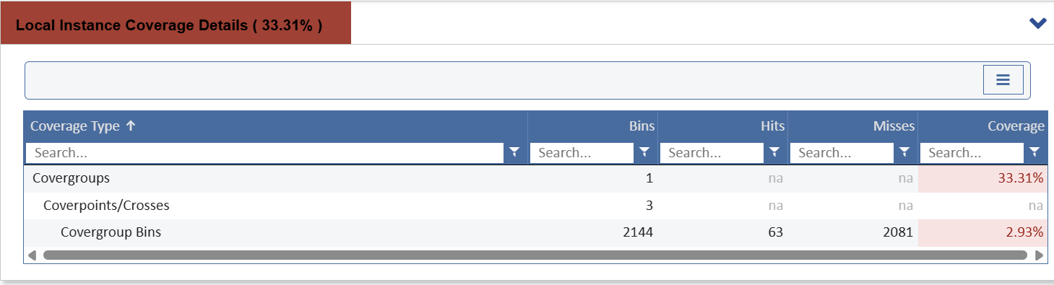
Test Coverage and Results (Bit-Flip Fault, Random Generation)

Slide 22

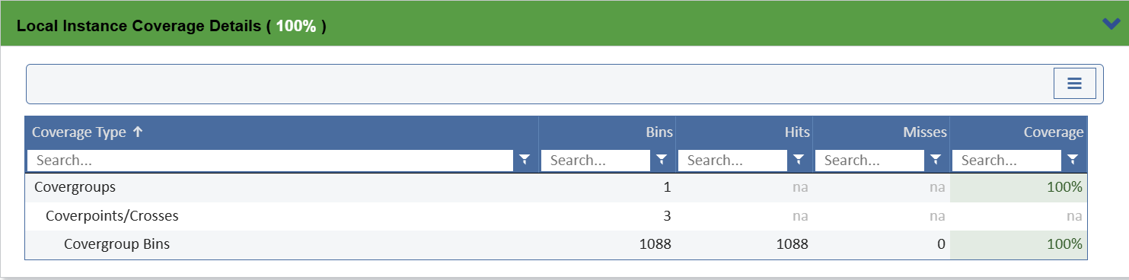
Test Coverage and Results (Bit-Flip Fault, Deterministic Inputs)

Slide 23
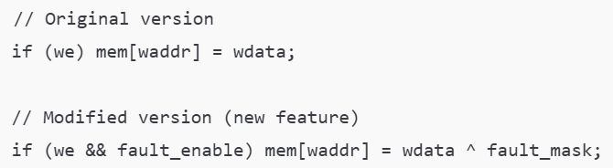
Regression
Example:
Goal of Regression Testing
It supports automation; running multiple testbenches with logging and coverage reports
It is crucial in iterative design and verification flows, especially when you:
Add new fault injection mechanisms
Introduce updated assertions or covergroups
If you didn’t re-run the original testbenches like tb_regfile_bitflip.sv or tb_regfile_all.sv, you would never realize that the data written during normal operation is being unintentionally flipped.
It seems like you added a new feature, but in reality, you’ve broken the basic functionality.
This silicon could not pass to DFT, Physical , and tapout.

Slide 24
The Concept of Regression code
1. Environment Setup
Clean and re-create the working simulation library / Create folders for logs and coverage reports
2. Compilation
Use vlog to compile RTL and TB files / Apply coverage options (like -cover sbcefx) to enable statement, branch, condition, expression, and toggle coverage
3. Simulation Execution
Use vsim -c to run simulations in command-line batch mode
4. Coverage Report Generation
Use vcover report to generate HTML reports / Use vcover merge to combine .ucdb files for summary and analysis

Slide 25
Conclusion and future work
Test Coverage ＆ Fault Detection Comparison Table
Test Type | Functional Coverage | Fault Detection Rate | Notes
Bit-Flip Fault | Low (e.g. ~33%) | High (100%) | Coverage is low because flips target random combinations, but many flips cause visible effects.
Multi-Bit Faults | High (≥97%) | High (≥97%) | Multiple bits flipped per test → more fault bins covered, higher chance of detection.
All Single-Bit Faults | Very High (100%) | Moderate (~51%) | Systematically inject all 2048 faults, but many do not propagate to outputs (masked).
For regression part, we may purchase license to achieve advanced simulation software functions.

Slide 26
Future work
Try multi-bit-flip faults testing, increase fault coverage
Fault Type | Per Register | Total (32 Registers)
1-bit flip | 32 | 32 x 32 = 1024 faults
2-bit flip as a group | 496 | 496 x 32 = 15,872 faults
3-bit flip as a group | 4,960 | 4960 x 32 = 158,720 faults
Subtotal | 5,488 | 176,616 faults

Slide 27


